Slide 1

Car Price Prediction Using Machine Learning
In this presentation we will show how machine learning can be used to predict car prices.
Date:- 25th Nov.2024
By
Kush Kumar
102203622

Slide 2

Introduction
Purpose
Objectives
The purpose of this project is to develop a robust model for accurately predicting Car prices by analyzing historical data and uncovering key factors that influence pricing trends.
We will implement a linear regression model, clean and preprocess the dataset, and provide insights into factors influencing car prices.

Slide 3
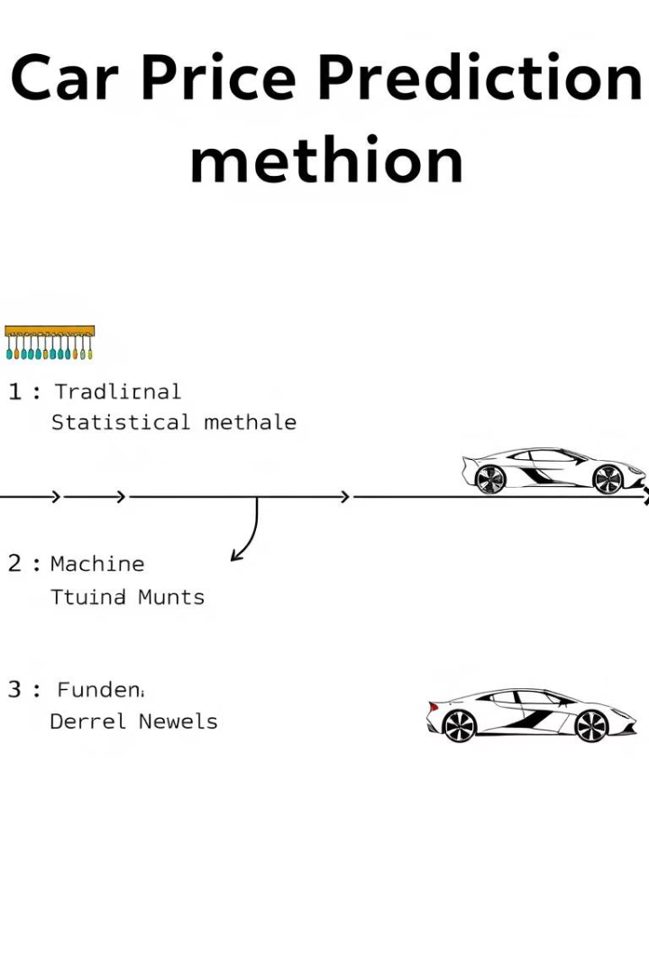


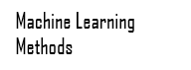

Literature Review
1
The car price prediction field has evolved from traditional statistical modeling and expert systems to more advanced machine learning techniques.
2
Machine learning has become the preferred approach due to its ability to handle complex patterns and deliver highly accurate predictions.
3
Linear regression, a simple yet powerful approach, was chosen for its interpretability and ability to capture linear relationships between features and price.

Slide 4
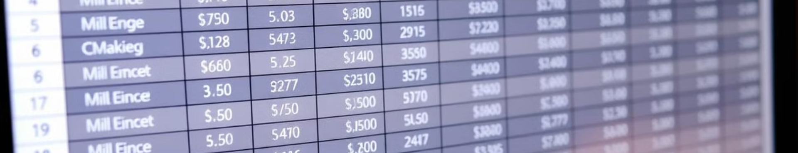
Dataset Overview
Source
Kaggle
Features
Name, Year, Company, Kms_driven, Fuel_type Price
Preprocessing
Missing value handling, duplicate removal, outlier removal

Slide 5





Methodology
Data Collection
The dataset was downloaded from Kaggle in csv format.
Data Cleaning
The dataset underwent cleaning to remove irrelevant information and handle missing values, ensuring data quality.
Data Preprocessing
Features were normalized and categorical variables were encoded to prepare the data for the model . With the help of One Hot Encoding name, company,
fuel_type were Converted into numerical values.
Model Training
The linear regression model was trained using the prepared data, learning patterns between features and prices.
Model Evaluation
The model's performance was evaluated using metrics like R-squared, testing its accuracy on unseen data.

Slide 6



Linear Regression Model
Equation
1
y=mx+c where x is independent variable, y is dependent variable.
Input Features
2
Company, Year, Name, Model, Kms_driven, and Fuel_type.
Target Variable
3
Price, the value we aim to predict.

Slide 7
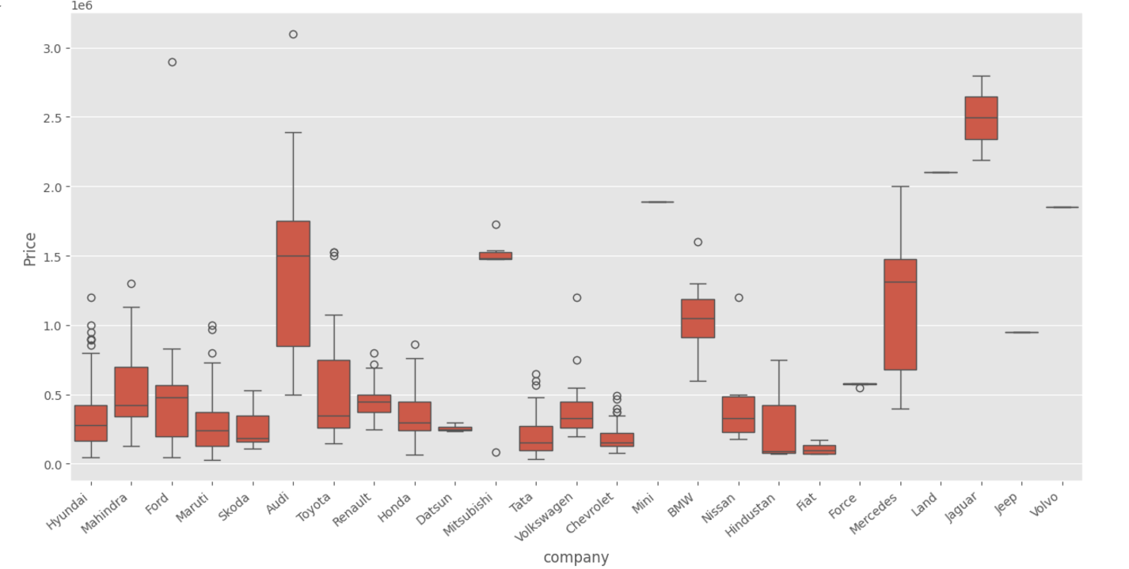
Visualizations
1. Box Plot Boxplot showing the distribution of prices for each company

Slide 8
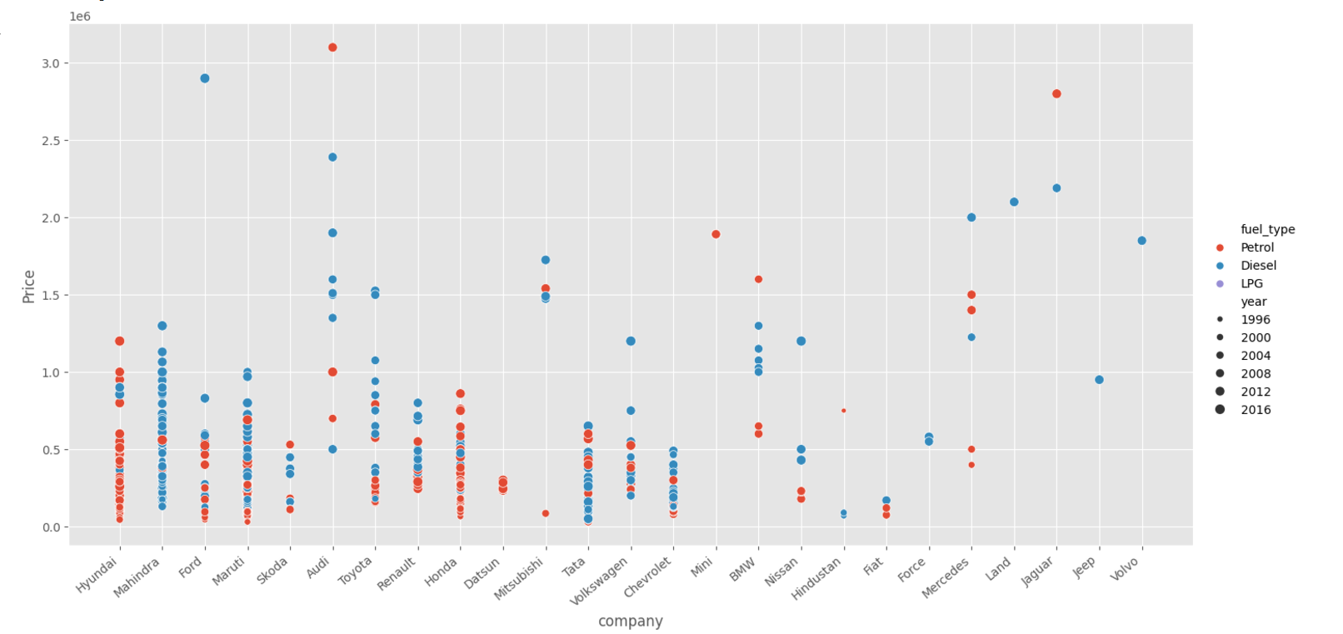
2. Scatter Plot

Slide 9
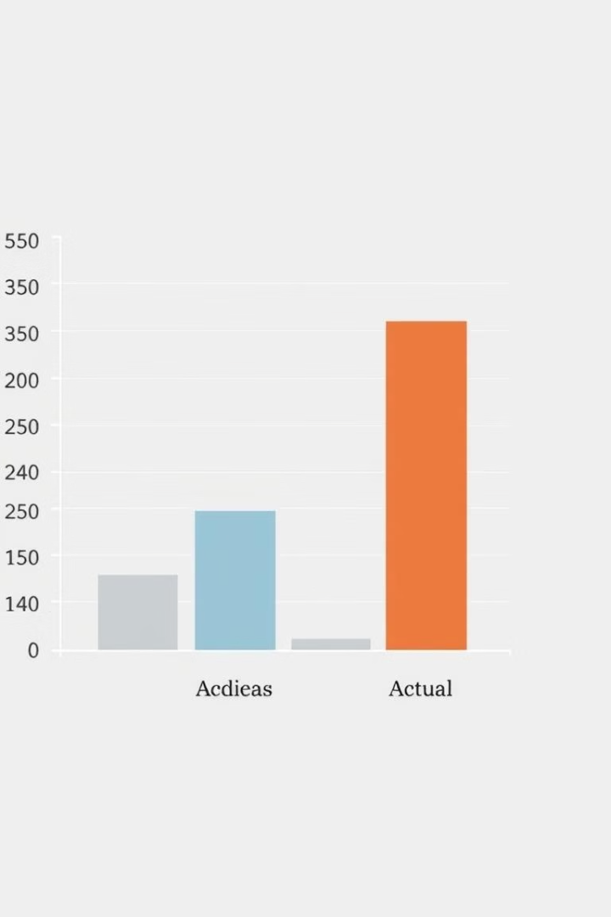

Results
0.89
Distance
R²
Significant Predictor
The model achieved an R-squared score of 0.89, indicating strong predictive power.
Kms_driven was a significant predictor of car price, with a negative correlation.

Slide 10

Conclusion
Accurate Predictions
Effective Model
Recommendations
The project successfully achieved accurate predictions of car prices using linear regression.
Linear regression proved to be an effective model, capable of capturing linear relationships between features and price.
Using a larger dataset and exploring more complex models could further enhance prediction accuracy.

Slide 11

References
Kaggle Dataset: Quikr car dataset
Python Libraries: pandas, scikit-learn

Slide 12

Thank You

